Slide 1
Introduction to
Natural Language Processing CS505 Spring 2022

Slide 2
Course Information
CS505 (Discussion and Resources @Piazza)
https://piazza.com/bu/spring2022/cs505/info
Lectures: Tuesday and Thursday 8 – 9.15 am at CAS 211 or Zoom: https://bostonu.zoom.us/j/98138949567?pwd=M2dDWmtrR09tbGNGYmZjbTdCa2sxQT09 Lab: held on the week an assignment is due

Slide 3
Course Information
Office hour:
(Derry) Fridays 10-11am at Zoom
(TAs) Check Piazza for information
Professor: Derry Wijaya (wijaya@bu.edu)
TA: Yusuf Kocygit (kocyigit@bu.edu)
TA: Afra Feyza Akyurek (akyurek@bu.edu)

Slide 4
Professor Wijaya
Bachelors from National University of Singapore
PhD from Carnegie Mellon University
Postdoc at University of Pennsylvania
Developed interest in the field of Information Extraction as an undergraduate doing UROP

Slide 5
What will you learn?
This is a introduction class to natural language processing
Focus will be on introducing you to (1) key concepts from NLP used to describe and analyze languages (2) how to process and analyze language data

Slide 6
Topics
We’ll cover topics in Jurafsky and Martin, Speech and Language Processing, 3rd edition (draft available online: https://web.stanford.edu/~jurafsky/slp3/
Topics include: text processing, text classification, language modeling, vector semantics, neural language modeling, recurrent neural networks for NLP, unsupervised learning, part-of-speech tagging, context free grammar and parsing, information extraction, machine translation, QA, dialogue systems

Slide 7
Assignments
There are 5 assignments that include programming in Python that must be done individually
~1 assignment every 2 weeks:
Assignments will be released on Fridays
Due on Sunday (midnight EST) the following week

Slide 8
Grading
Each assignment contributes 12 points
Lecture attendance (%) OR Piazza participation (top-10) (bonus up to 5 points)
https://forms.gle/ifktRCxa4BfEdDrH7
If you cannot attend but want to get attendance point, please watch the video and create a short summary of the lecture and submit it via this Form: https://forms.gle/AYSHyQo5M2tdFLUu5
Project: Team of 5 (20 points for presentation, 20 points for write-up)

Slide 9
About Assignments
This class will have individual programming assignments that are intense
The assignments will be real-life programming assignments using real-world datasets (no toy datasets here)
You will get hands-on experience on scraping, processing, cleaning, and analyzing textual data – things you will actually need to know at your current/future work
The focus is on building end-to-end actual NLP systems
Require experience in Python programming and for machine learning

Slide 10
Important Dates
Feb 2, 2022 Last day to ADD course
Feb 24, 2022 Last day to DROP course (w/o ”W”)
Apr 1, 2022 Last day to DROP with a ”W” grade

Slide 11
About Assignments
This is also a class that is Introduction to NLP so by definition, students come from various backgrounds
Therefore, there may be people who will find it not challenging enough
Email me if you want extra challenge – I can give extra, research-level NLP, challenge for you

Slide 12
Mark Your Dates
Linguistics and NLP Talks
Thursday, Feb. 3, 2022 (5:00pm-6:00pm, RKC-101) - Nelson Flores (University of Pennsylvania)
Monday, Feb. 28, 2022 (4:30pm-5:30pm, location TBA) - Tracy Conner (Northwestern University)
Monday, Mar. 28, 2022 (4:30pm-5:30pm, location TBA) - Najoung Kim (New York University)
Monday, Apr 11, 2022 (11am – 12.30pm, location TBA) – Lucia Specia (Imperial College London)
Monday, Apr. 25, 2022 (4:30pm-5:30pm, location TBA) - Norma Mendoza-Denton (University of California, Los Angeles)

Slide 13

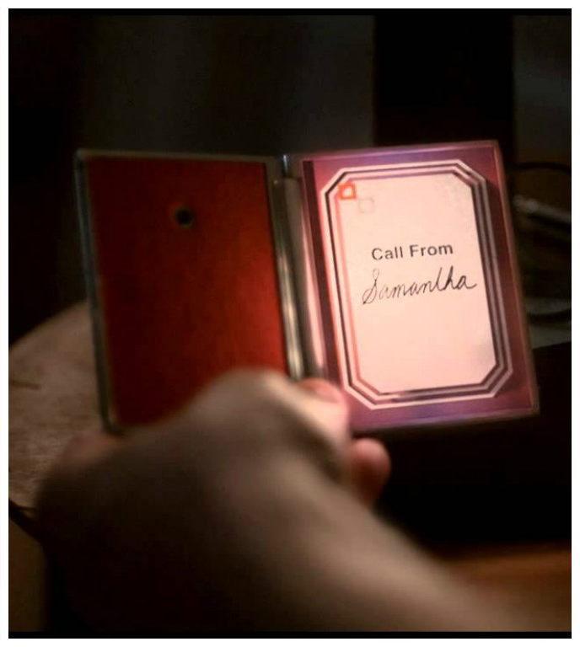
Introduction
HAL 9000 in 2001: A Space Odyssey (1968)
Her (2013)

Slide 14
Introduction
Natural Language Processing
techniques to give computers the ability to process, learn, and understand human languages
other names: speech and language processing, human language technologies, computational linguistics, speech recognition and synthesis, …

Slide 15

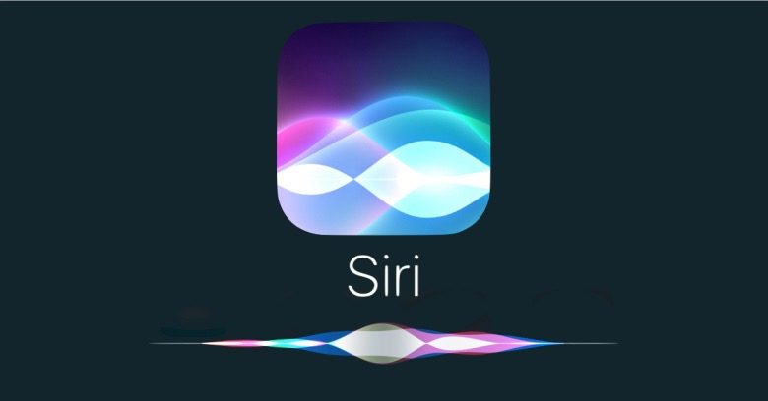
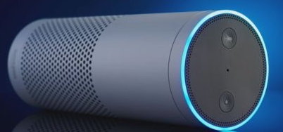





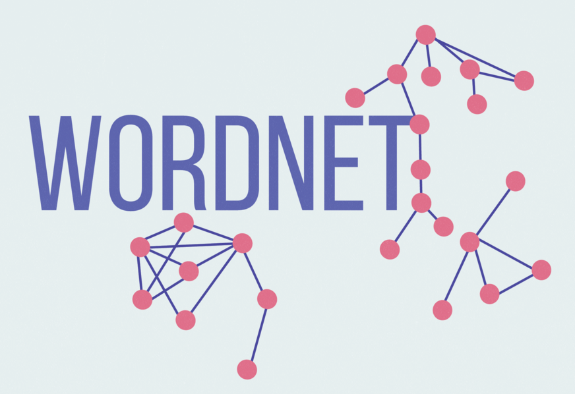
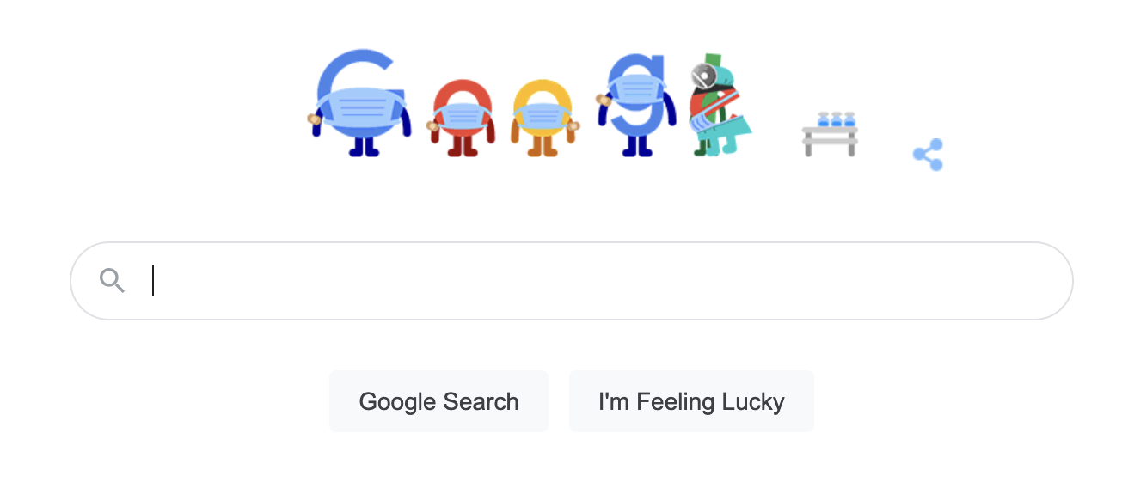
Goal of NLP
get computers to perform tasks involving human language
conversational agent
machine translation (MT)
question answering (QA)
information extraction (IE)
word sense disambiguation (WSD)
search engine ...
nell

Slide 16
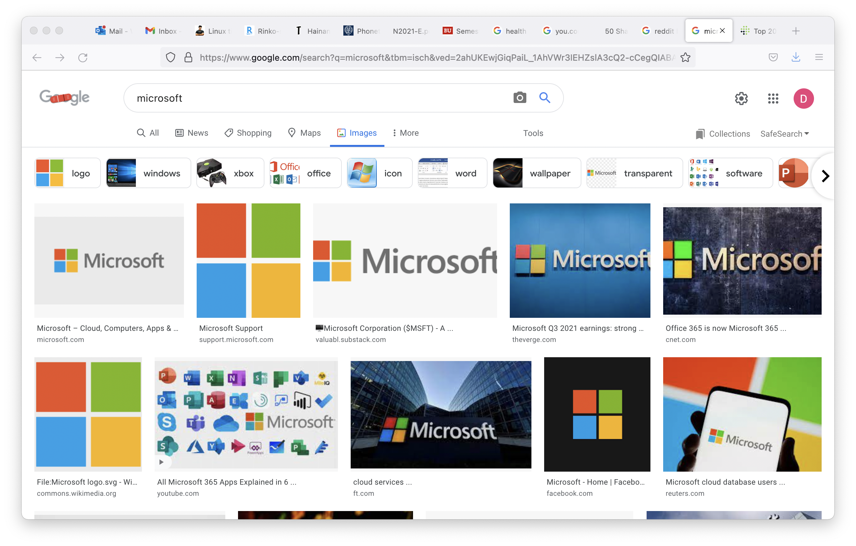
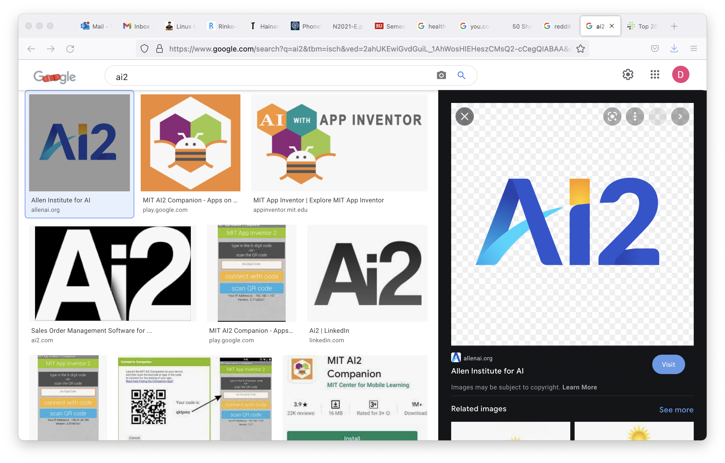


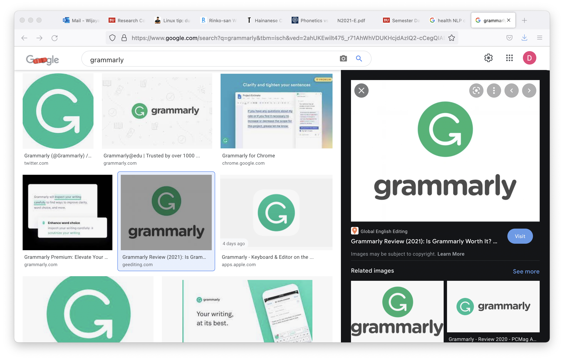
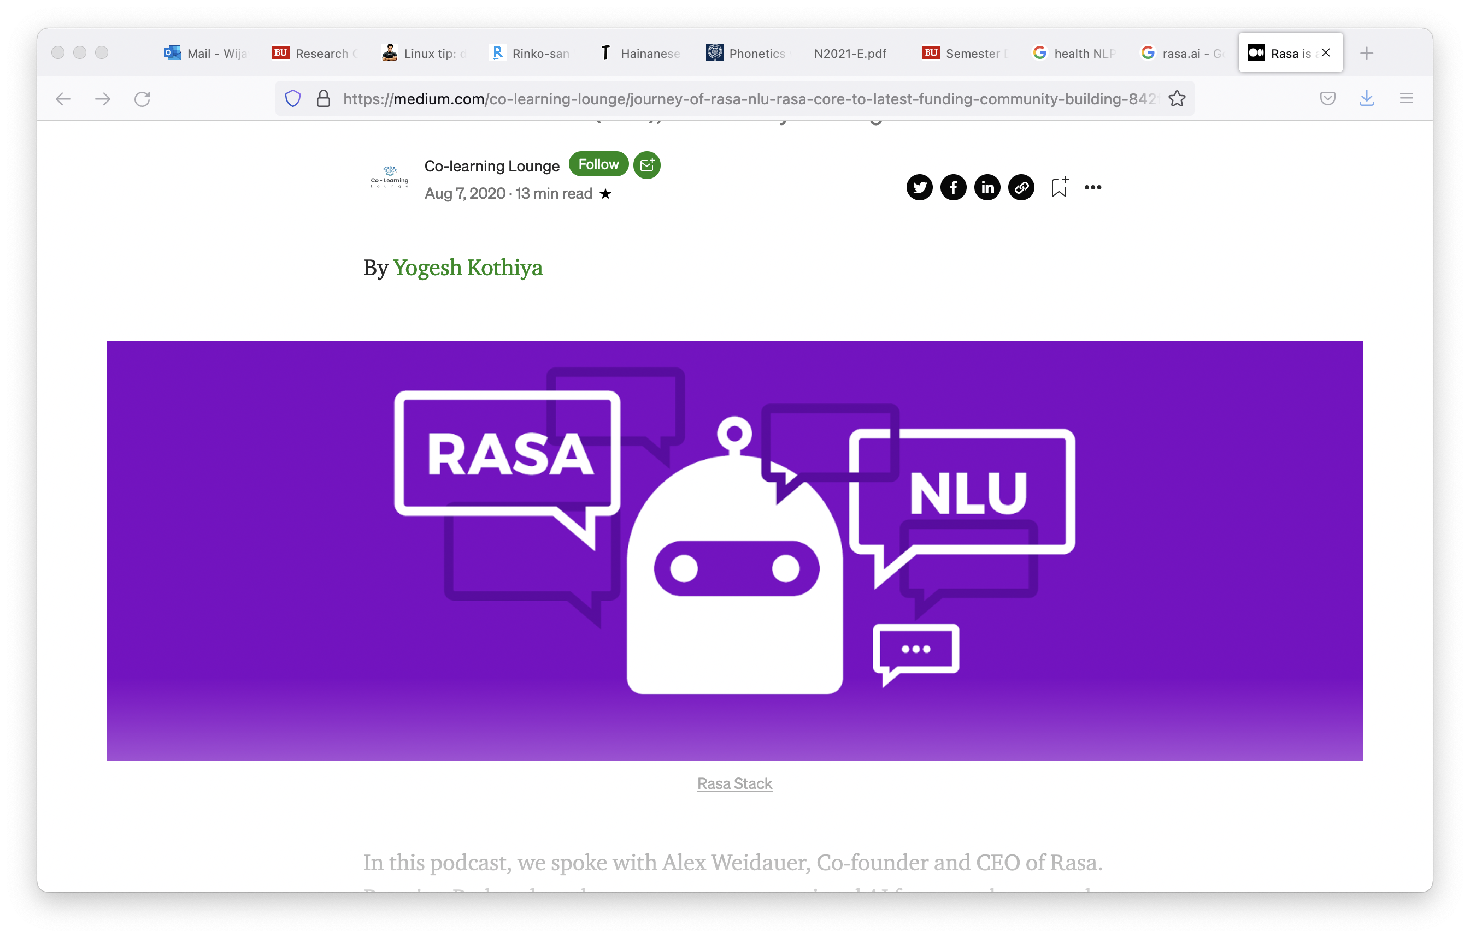

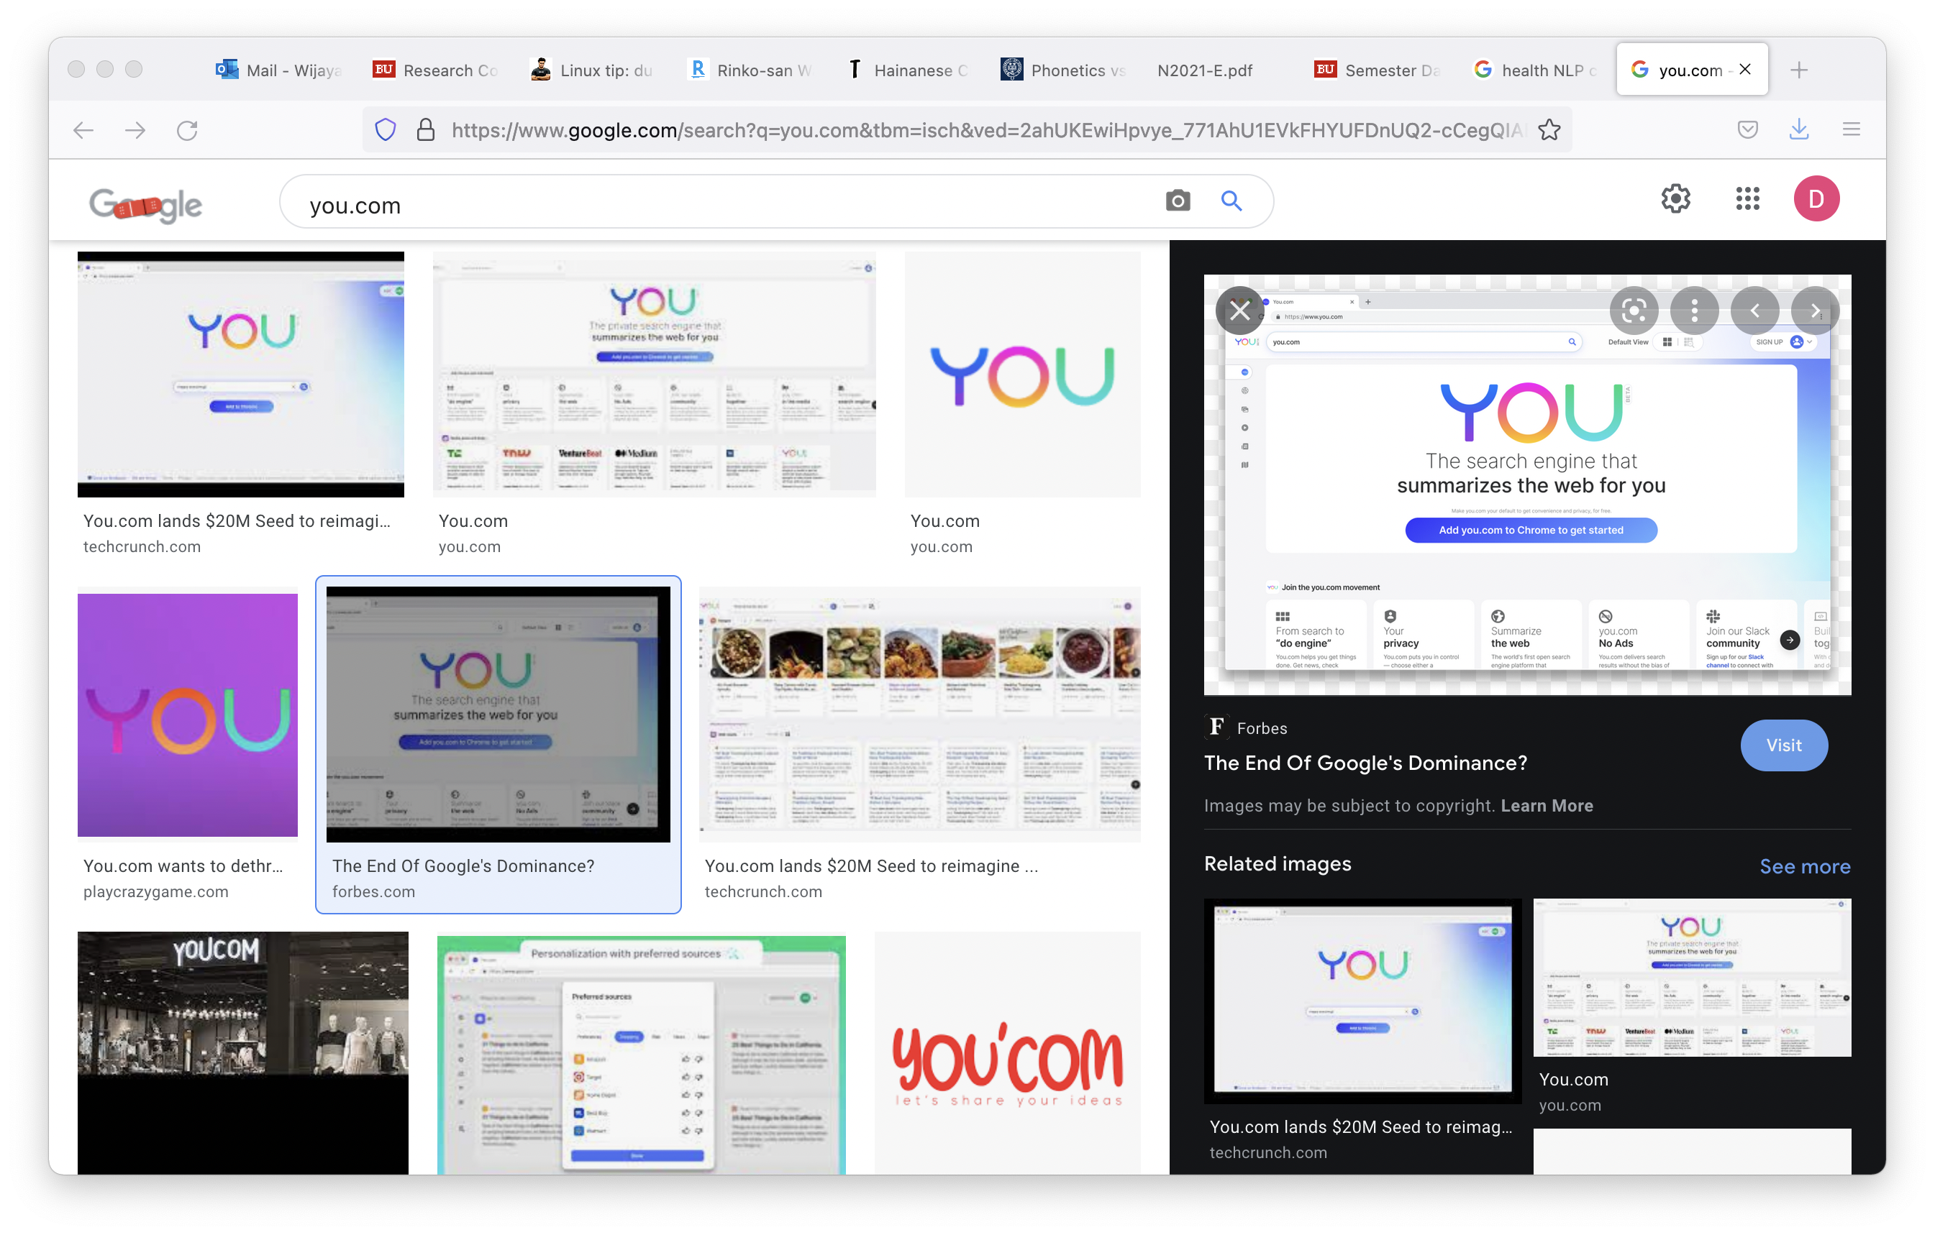

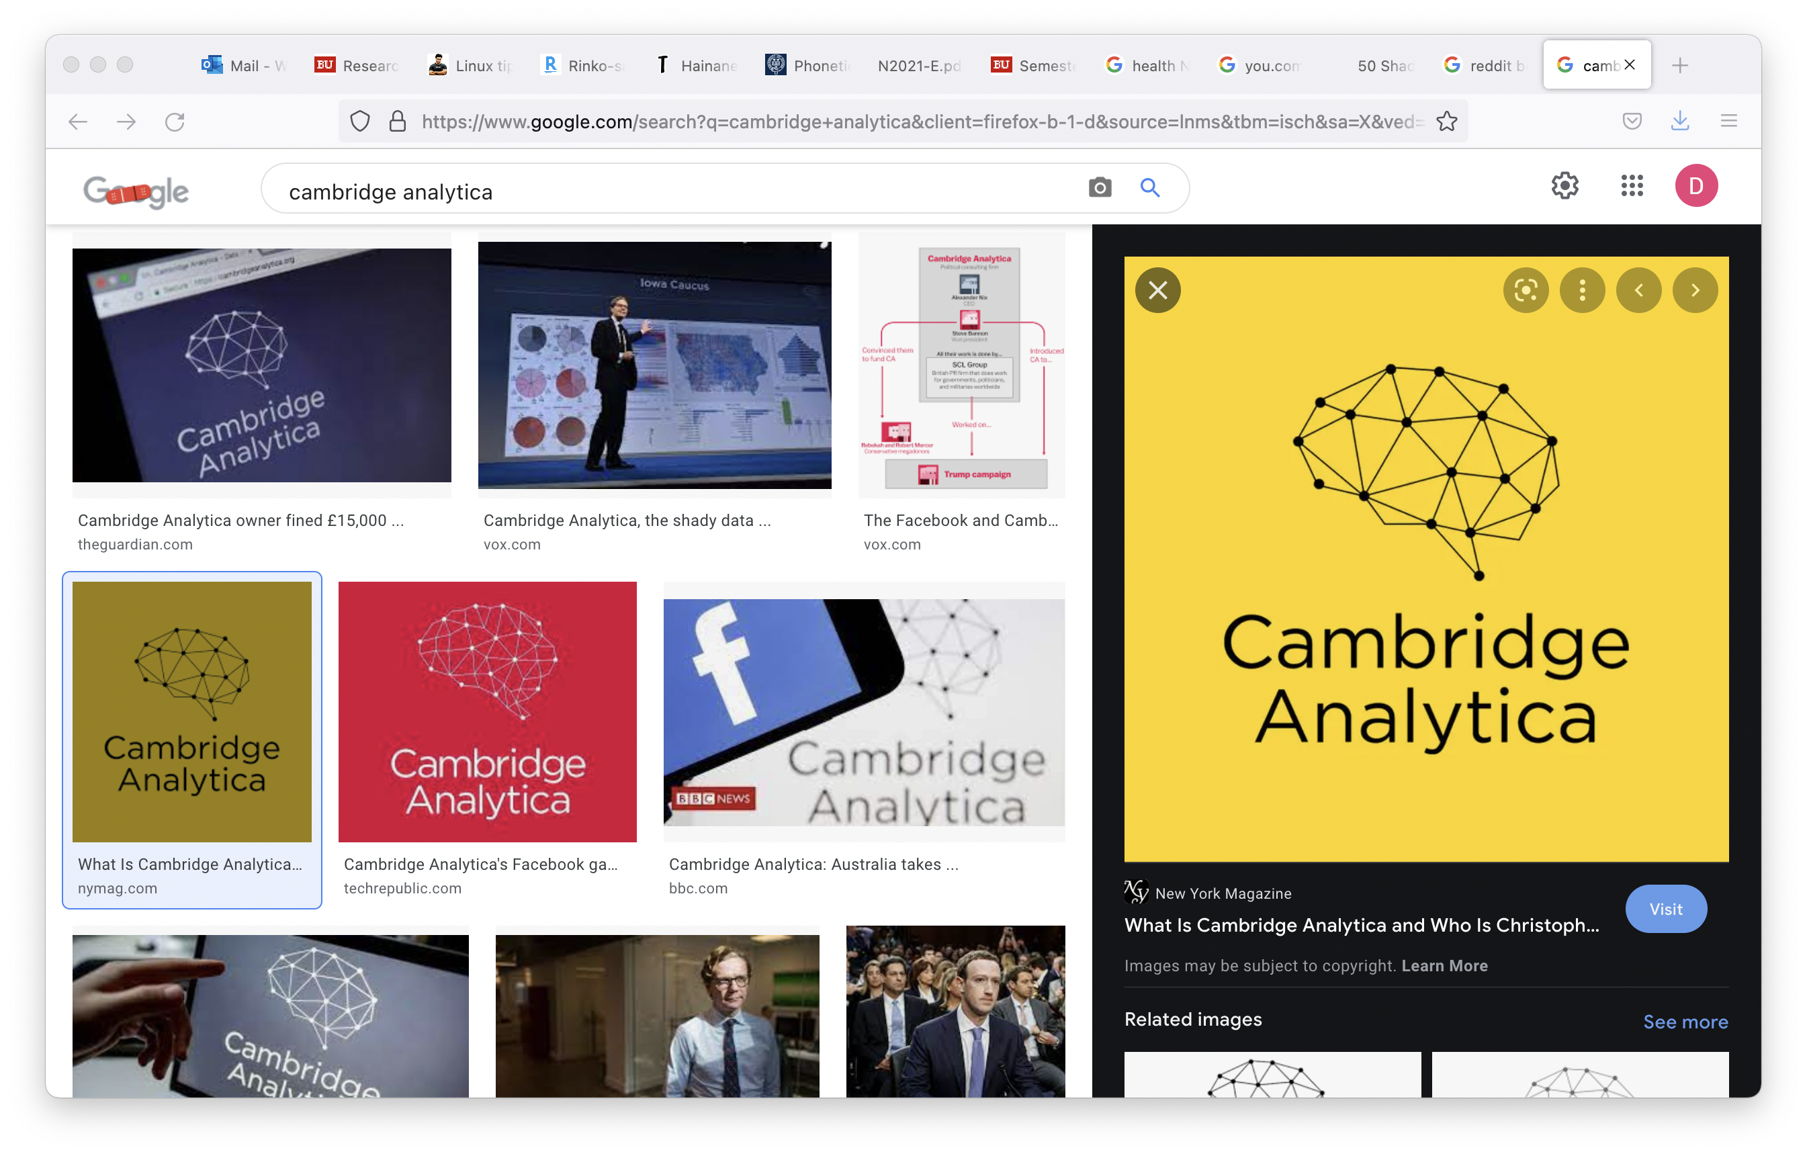
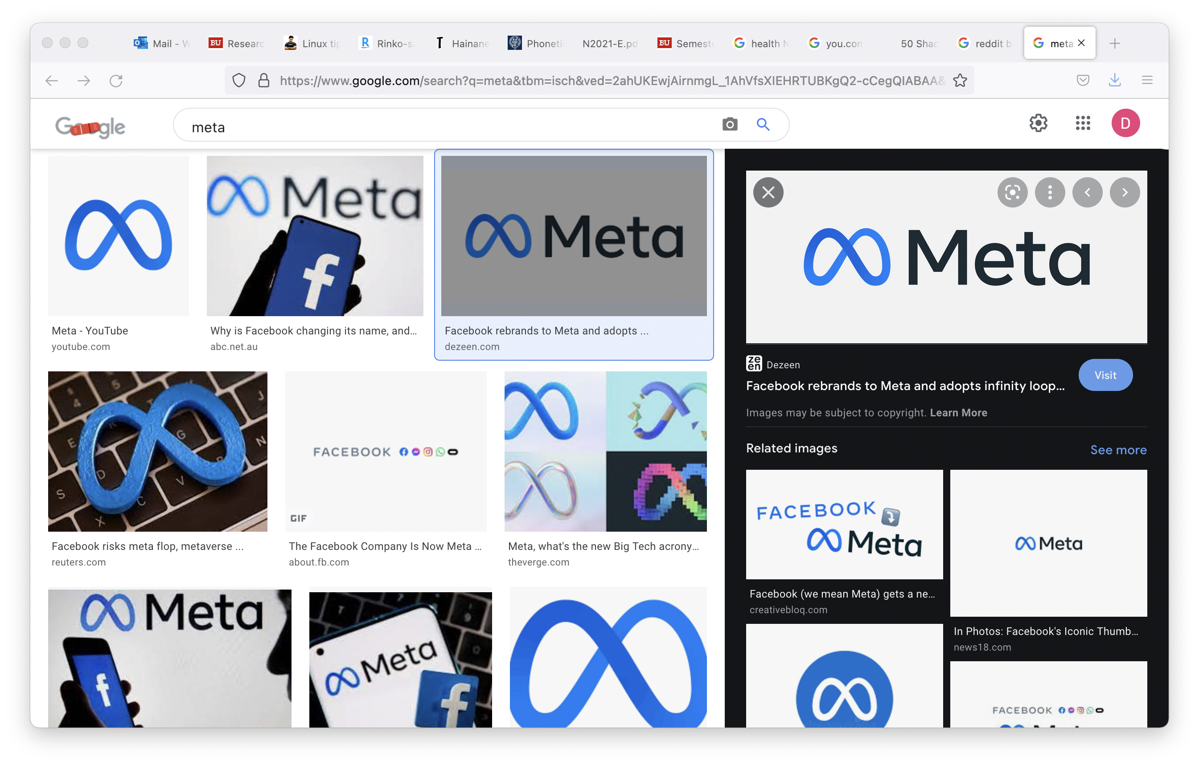
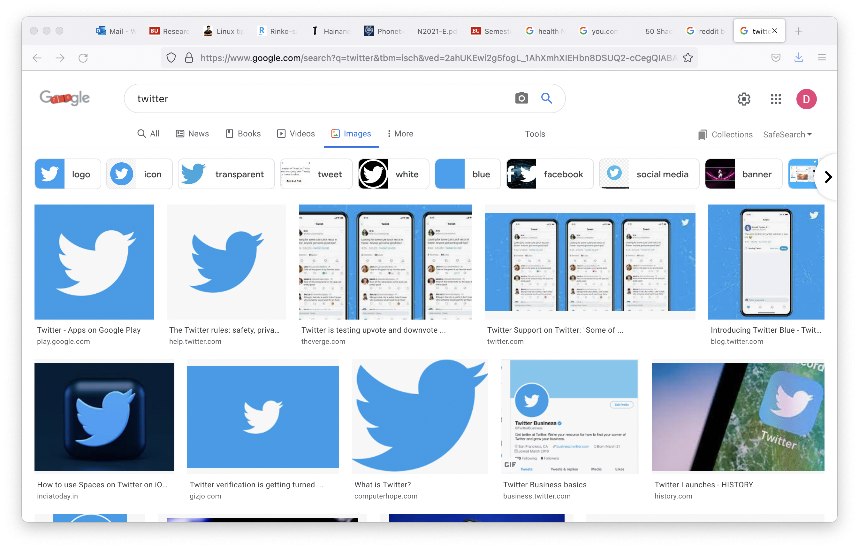
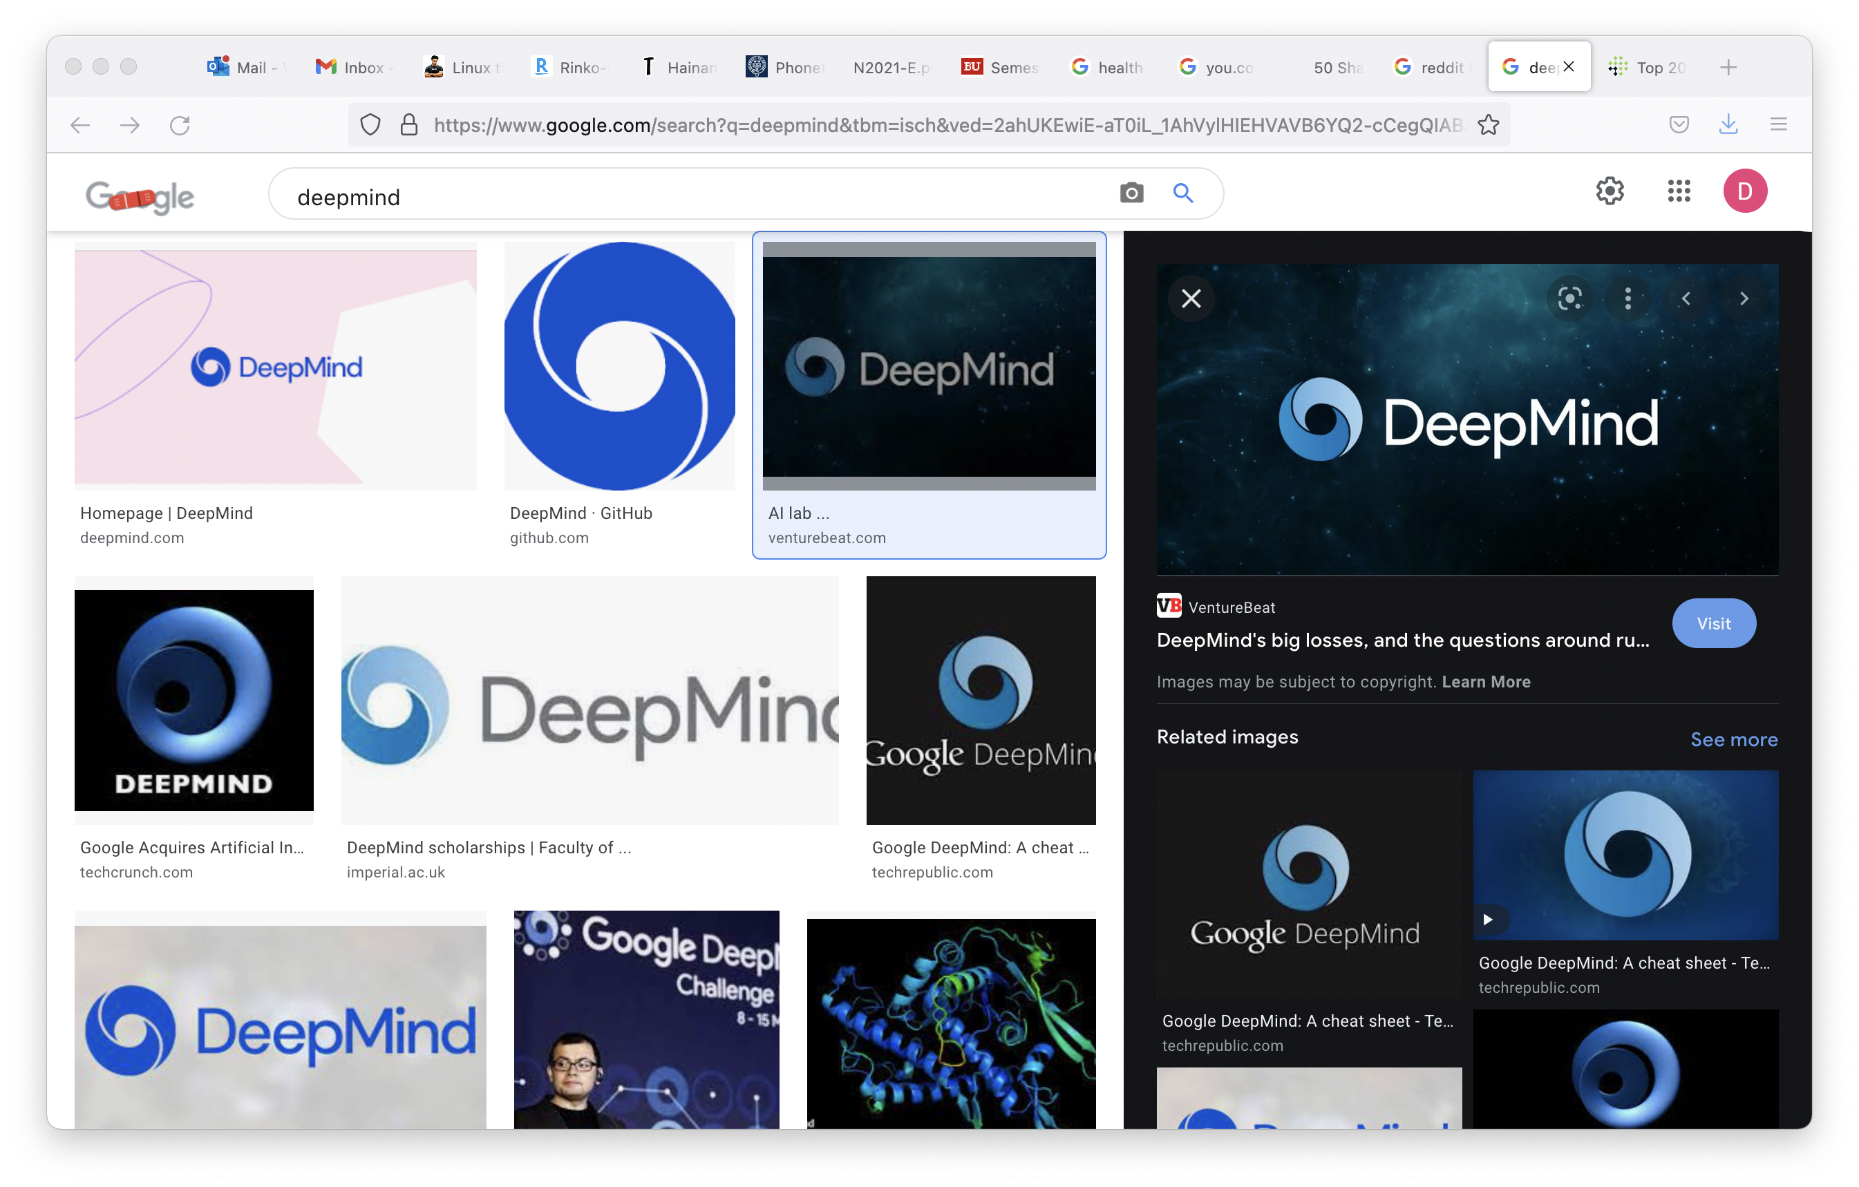
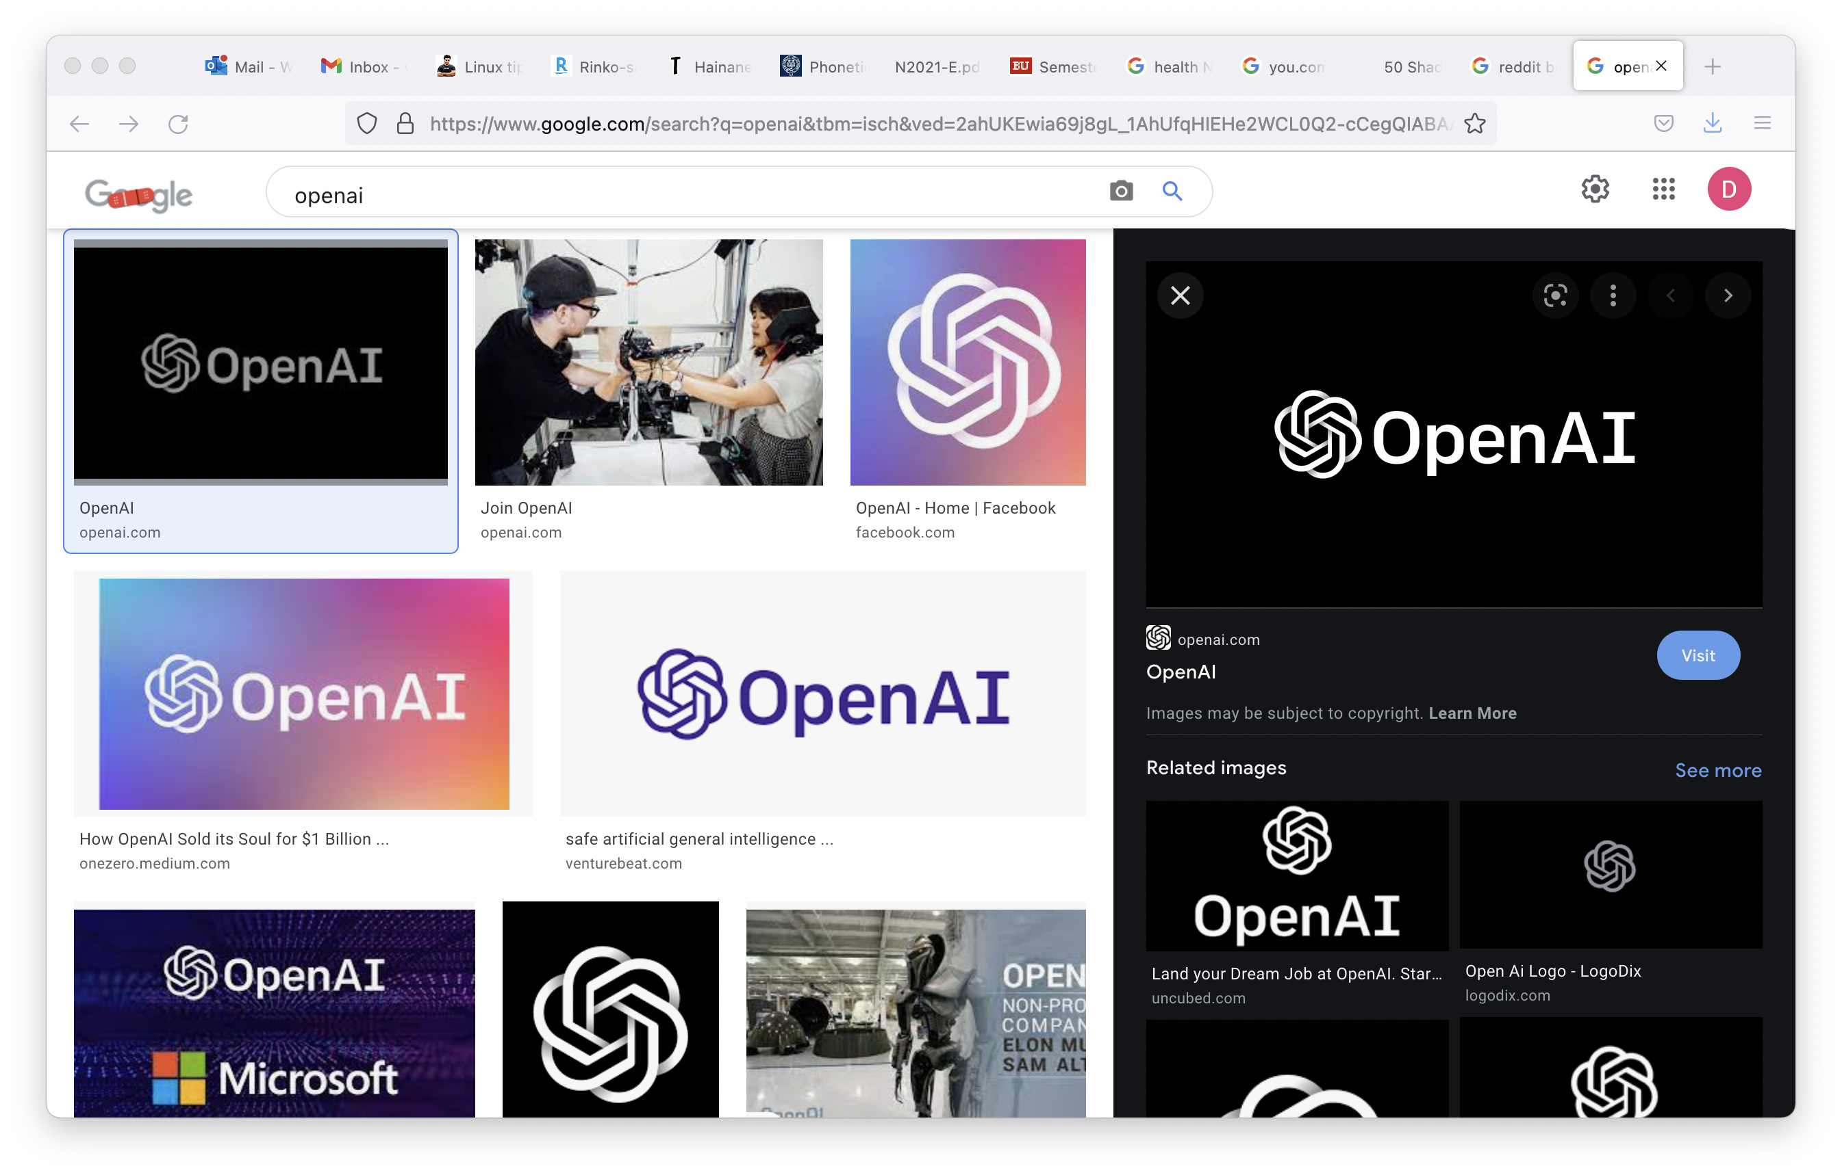
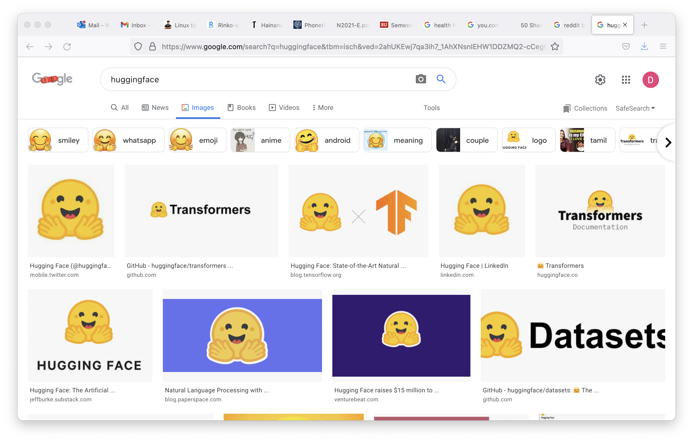
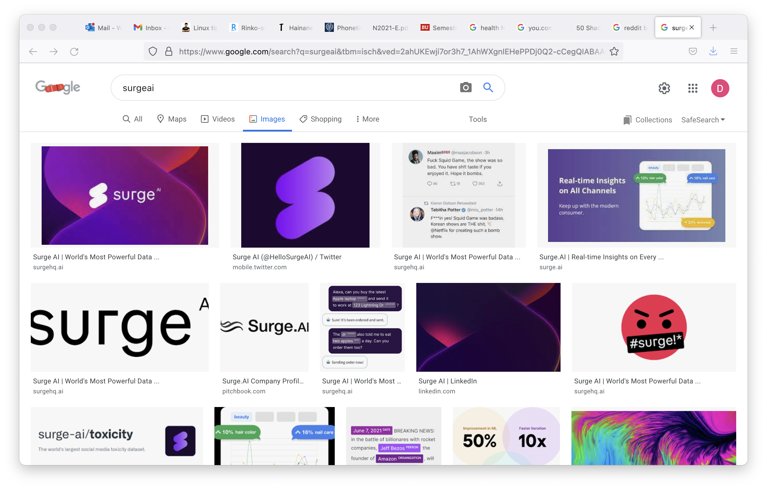

Goal of NLP
get computers to perform tasks involving human language
...

Slide 17
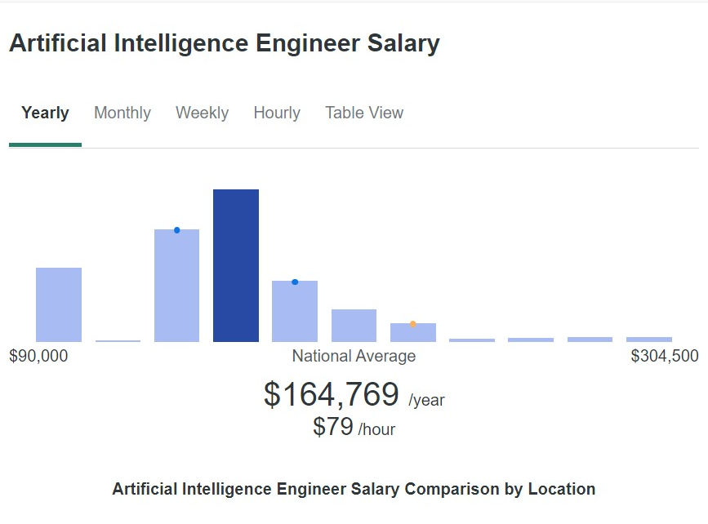
Goal of NLP-practitioner
get computers to perform tasks involving human language

Slide 18
To A Computer
bakaji bavwa bamona muana. baluma bavwa bamona bakaji. Tubambwa tuvwa tumona baluma. kanzolu kavwa kamona tubambwa. cimuma civwa cimona ntambwe. ntambwe uvwa mumona tubimuma.
This text
To a non-speaker of the language

Slide 19
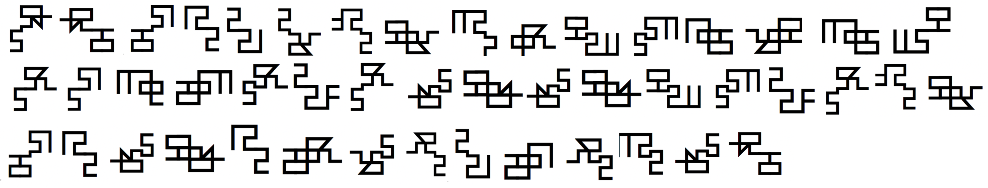
To A Computer
This text
To a non-speaker of the language

Slide 20

Goal of NLP
Computer solving task involving human language
Knowledge of Language
Algorithm
task
solve ambiguity
capture
Model
Image source: medium.com

Slide 21
Goal of NLP
Computer solving task involving human language
Knowledge of Language
Algorithm
task
Model
Image source: medium.com

Slide 22

Knowledge of Language
phonetics: production of sounds: physical description of sounds (position of mouth, tongue, etc.) i.e., how sounds are used in human speech
phonology: patterns of sounds: description of sound interrelation and function i.e., how speech sounds are used in a particular language e.g., cart vs. coot
phonetics and phonology

Slide 23


Knowledge of Language
different variations of words e.g., door vs doors (singular vs. plural), kejar vs. dikejar (chase vs. to be chased, in Indonesian language)
structural knowledge to order and group words together
I’m sorry Dave, I’m afraid I can’t do that
(*) I’m I do, sorry that afraid Dave I’m I can’t
morphology
syntax

Slide 24


Knowledge of Language
meaning of words e.g., to answer the question:
need to know the meaning of “silk”, “export”, …
lexical semantics
How much Chinese silk was exported to Western Europe by the end of the 18th century?

Slide 25


Knowledge of Language
compositional semantics
meaning of words in combination e.g., to answer the question:
need to know the meaning of Chinese silk as opposed to Assam silk, for example; or what Western Europe means as opposed to Eastern Europe; or what end of the 18th century mean as opposed to end of that road?
How much Chinese silk was exported to Western Europe by the end of the 18th century?

Slide 26

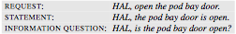
Knowledge of Language
pragmatic
knowledge about the kind of actions that speakers intend by their use of sentences

Slide 27

Knowledge of Language
discourse
knowledge about linguistic units larger than a single utterance e.g., coreference resolution, “that year” == “the year Abraham Lincoln was born”

Slide 28
Goal of NLP
Computer solving task involving human language
Knowledge of Language
Algorithm
task
Model
Image source: medium.com

Slide 29

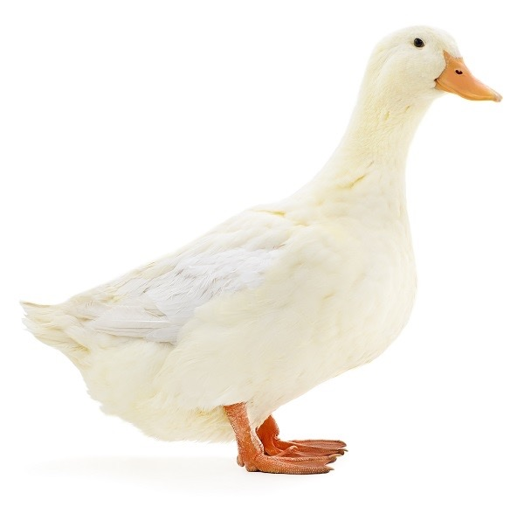
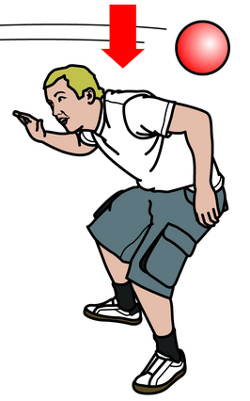
Ambiguity
Most tasks in NLP are about resolving ambiguities
I made her duck
noun?
verb?
a duck
he ducks
the ducks
he ducked
it’s a duck
he’s ducking
(*) he duck
(*) a ducked
resolving part-of-speech (morphology)
words with same part-of-speech share similar forms

Slide 30
Ambiguity
Most tasks in NLP are about resolving ambiguities
I made her duck
dative pronoun?
possessive pronoun?
“I cooked her a duck dish”
“I cooked the duck dish belonging to her”
resolving syntactic ambiguity

Slide 31
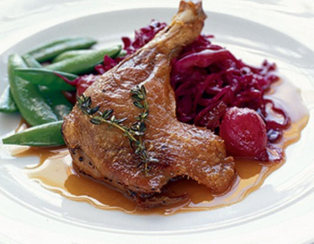

Ambiguity
Most tasks in NLP are about resolving ambiguities
I made her duck
cooked?
created?
resolving semantic ambiguity (word senses)

Slide 32
Goal of NLP
Computer solving task involving human language
Knowledge of Language
Algorithm
task
solve ambiguity
Model
Image source: medium.com

Slide 33
Goal of NLP
Computer solving task involving human language
Knowledge of Language
Algorithm
task
solve ambiguity
Model
Image source: medium.com

Slide 34
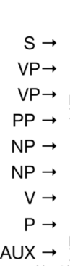
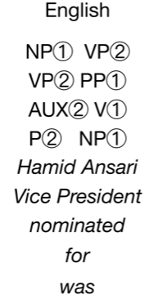

Models
NLP systems rely on models to capture knowledge of language e.g., formal rule systems to capture phonology, morphology, and syntax
“Hamid Ansari was nominated
for Vice President”
context free
grammar
“Vice President was nominated
for Hamid Ansari”
“Hamid Ansari was nominated”
“Vice President was nominated”
a set of production rules that
describe all possible strings
rules can be applied
regardless of context

Slide 35
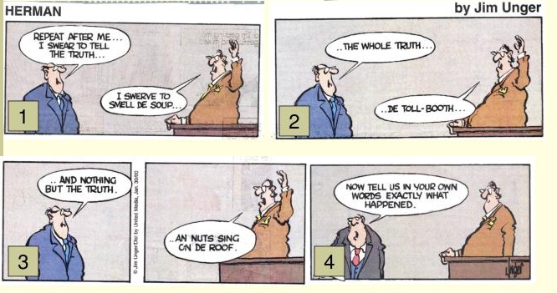
Models
e.g., probabilistic models: ambiguity problems can be recast as “given N choices for some ambiguous input, choose the most probable one”

Slide 36
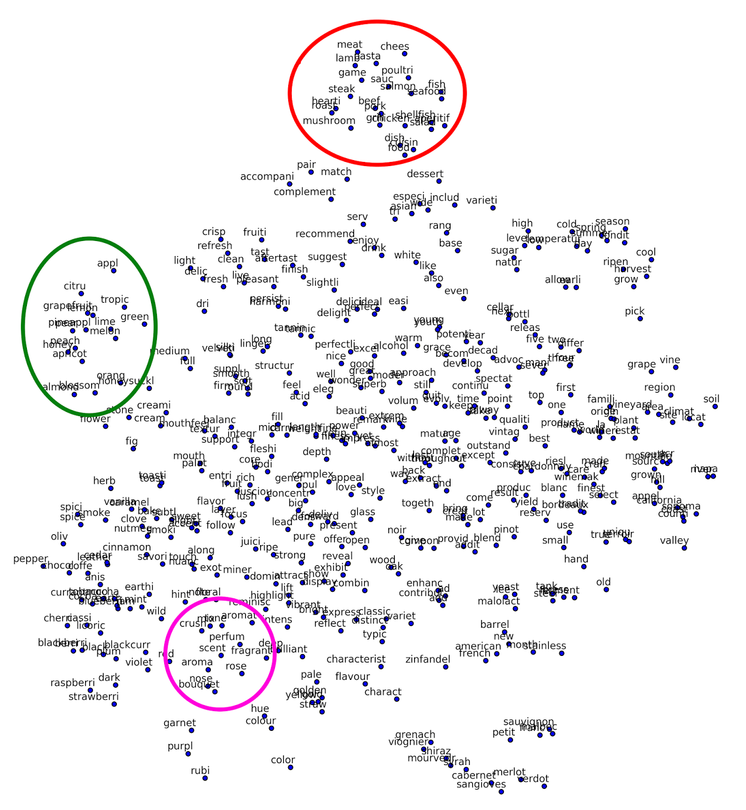
Models
e.g., vector space models to capture word meanings “you shall know a word by the company it keeps (Firth, J. R. 1957:11)”
pasta, lamb,
cheese, mushroom
citrus, apple,
orange, lime
aromatic, nose,
scent, perfume
http://methodmatters.blogspot.com/2017/11/using-word2vec-to-analyze-word.html

Slide 37
End of Lecture 1

Slide 38
Beginning of Lecture 2

Slide 39
Goal of NLP
Computer solving task involving human language
Knowledge of Language
Algorithm
task
solve ambiguity
capture
Model
Image source: medium.com

Slide 40
Goal of NLP
Computer solving task involving human language
Algorithm
Knowledge of Language
task
solve ambiguity
capture
Model
Image source: medium.com

Slide 41
Algorithms
Given the models, search through a space of hypotheses about an input
e.g., a classifier can be trained to compute the sentiment polarity of a word i.e., whether it conveys a positive/negative sentiment based on the word vector
e.g., a machine translation algorithm searches through a space of translation hypotheses for the correct translation of a sentence into another language

Slide 42
Goal of NLP
Computer solving task involving human language
Knowledge of Language
Algorithm
task
solve ambiguity
capture
Model
Image source: medium.com

Slide 43

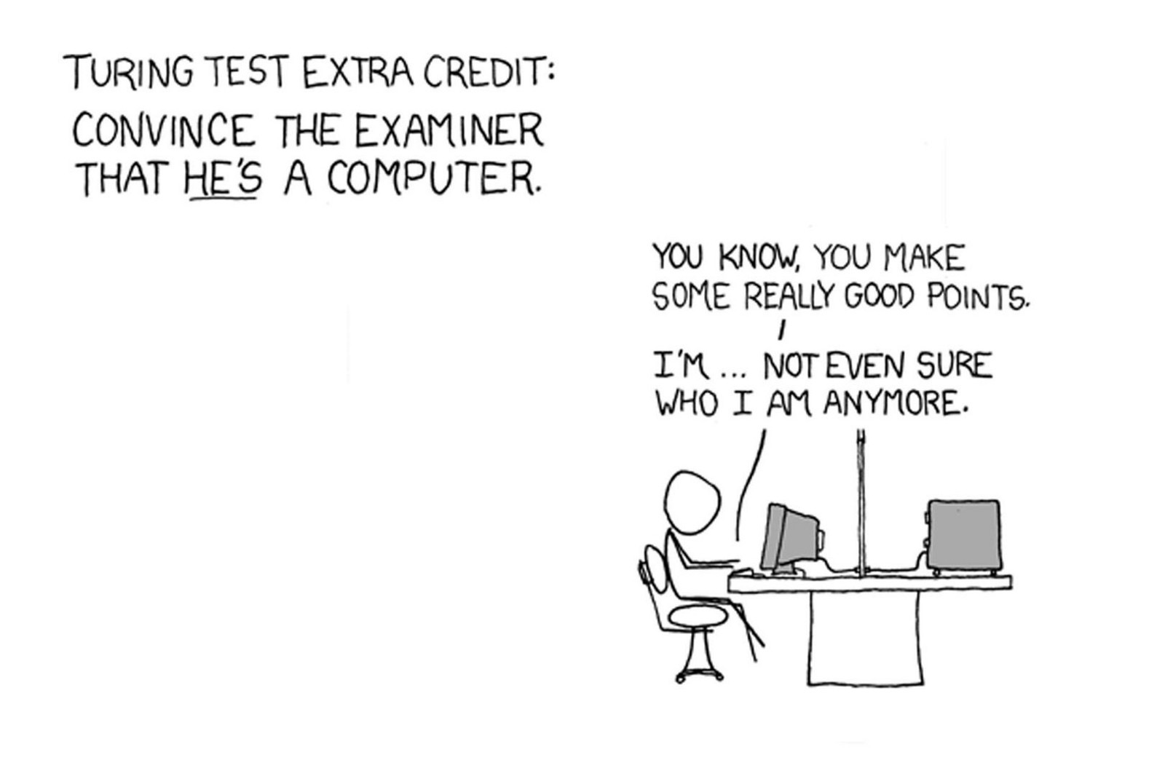
NLP and the Measure of Intelligence
using language as humans do
== truly intelligent machines?
Turing Test by responding as a person to the examiner’s questions, the machine wins if it can convince the examiner into believing that it is a person
https://xkcd.com/329/
Notes:
In Turing’s game, there are three participants: two people and a computer. One of the people is a contestant who plays the role of an interrogator. To win, the interrogator must determine which of the other two participants is the machine by asking a series of questions via a teletype. The task of the machine is to fool the interrogator into believing it is a person by responding as a person would to the interrogator’s questions. The task of the second human participant is to convince the interrogator that the other participant is the machine and that she is human.

Slide 44
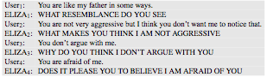
NLP and the Measure of Intelligence
ELIZA program (Weizenbaum, 1966)
NLP system that imitates a psychotherapist
ELIZA uses pattern matching, knows nothing of the world,
but many people thought that it really understood them and their problems!
Notes:
In Turing’s game, there are three participants: two people and a computer. One of the people is a contestant who plays the role of an interrogator. To win, the interrogator must determine which of the other two participants is the machine by asking a series of questions via a teletype. The task of the machine is to fool the interrogator into believing it is a person by responding as a person would to the interrogator’s questions. The task of the second human participant is to convince the interrogator that the other participant is the machine and that she is human.

Slide 45

NLP and the Measure of Intelligence
ELIZA program (Weizenbaum, 1966)
NLP system that imitates a psychotherapist
says more about the people than
about the machine
ELIZA uses pattern matching, knows nothing of the world,
but many people thought that it really understood them and their problems!
Notes:
In Turing’s game, there are three participants: two people and a computer. One of the people is a contestant who plays the role of an interrogator. To win, the interrogator must determine which of the other two participants is the machine by asking a series of questions via a teletype. The task of the machine is to fool the interrogator into believing it is a person by responding as a person would to the interrogator’s questions. The task of the second human participant is to convince the interrogator that the other participant is the machine and that she is human.

Slide 46
NLP and the Measure of Intelligence
using language as humans do
== truly intelligent machines?
regardless, people talk about computers and
interact with them as social entities;
expecting computers to understand their needs and
be able to interact naturally (Reeves and Nass 1996)
Notes:
In Turing’s game, there are three participants: two people and a computer. One of the people is a contestant who plays the role of an interrogator. To win, the interrogator must determine which of the other two participants is the machine by asking a series of questions via a teletype. The task of the machine is to fool the interrogator into believing it is a person by responding as a person would to the interrogator’s questions. The task of the second human participant is to convince the interrogator that the other participant is the machine and that she is human.

Slide 47
NLP and the Measure of Intelligence
using language as humans do
== truly intelligent machines?
regardless, people talk about computers and
interact with them as social entities;
expecting computers to understand their needs and
be able to interact naturally (Reeves and Nass 1996)
The importance of NLP!
Notes:
In Turing’s game, there are three participants: two people and a computer. One of the people is a contestant who plays the role of an interrogator. To win, the interrogator must determine which of the other two participants is the machine by asking a series of questions via a teletype. The task of the machine is to fool the interrogator into believing it is a person by responding as a person would to the interrogator’s questions. The task of the second human participant is to convince the interrogator that the other participant is the machine and that she is human.

Slide 48
An Exciting Time for NLP!
Increase in computing resources
Increase in the amount of data and information available in digital form
Development of highly successful machine learning methods and competitive evaluations (SemEval, NIST, CoNLL shared tasks, Kaggle)
Richer understanding of the structure of human language and its deployment in social contexts

Slide 49
An Exciting Time for NLP!
Real world NLP systems
Conversational agents for making reservations
Voice assistant systems
Machine translation systems, speech-to-speech translation
Automated grading systems
Virtual tutors
Text analysis companies for marketing intelligence
…

Slide 50
State of the Art
Simple methods often work very well when trained on large quantities of data
e.g., many text and sentiment classifiers still rely on different sets of words (“bag of words”) without regard to sentence and discourse structure or meaning

Slide 51
State of the Art
However, most NLP resources and systems are available only for high resource languages
Many low resource languages are spoken by millions of people e.g., Bengali, Indonesian, Swahili, …
The challenge is how to develop resources and tools for thousands of languages, not just a few

Slide 52
Machine Translation
Challenging because correct translations require:
ability to analyze and generate sentences in human languages
understanding of world knowledge and context to resolve the ambiguities of languages
e.g., the French word “bordel” straightforward translation is “brothel” but what if someone says “My room is un bordel”?

Slide 53
Machine Translation
Started with hand-built grammar based systems (limited success)
Transformed with the availability of parallel sentences to collect statistics of word translations and word sequences
small word groups often have distinctive translations — phrase based MT, which formed the basis of Google translate

Slide 54
Machine Translation
Another transformation using deep learning-based sequence models
train a model with several representational levels to optimize translation quality
the model learns intermediate representations that are useful for translation

Slide 55
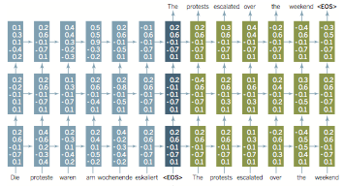
Machine Translation
Long Short Term Memory Network
maintain contextual information from early until late in a sentence
Notes:
Initially trained on parallel sentences that translate each other, the model learns a representation of each word as a real-valued vector and internal parameter matrices so as to optimize translation quality. The trained network can then translate new sentences. Each arrow represents a computation unit of a matrix multiplication followed by a nonlinear transformation; the small vectors shown in the illustration might really be 1000-dimensional. The recurrent network first encodes the meaning of the source sentence (left side, blue). It maintains an internal state representing a partial sentence, which is updated after each new word is read (horizontal arrows). Having the upper network layers [mapped to by additional (upper vertical) computation arrows] makes this a deep recurrent network. Adding depth improves the ability of the model to learn, generalize, and remember. Once the end of the sentence (denoted by <EOS>) is reached (middle, dark blue), the network additionally starts to produce a word of translated output at each step from its internal state (using a multiclass logistic regression–style model). During translation generation (right side, green), the last generated word is fed in as the input at each step. From the stored hidden state and this input, the model calculates the next word of the translation. This process repeats until <EOS> is generated.

Slide 56
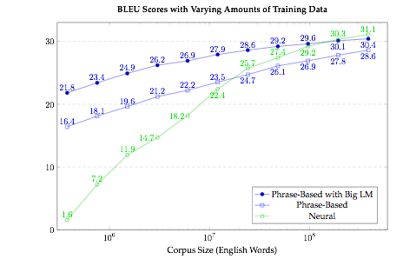
Machine Translation
Neural MT, Philipp Koehn

Slide 57
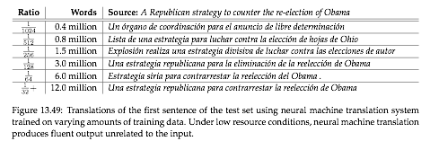
Machine Translation
Neural MT, Philipp Koehn

Slide 58
Lessons so far
More data -> better performance
Less data ?
new approach?
look for more data?

Slide 59
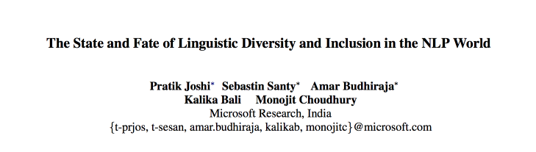
ACL 2020

Slide 60
The State
7000 languages
Only a small number are represented in NLP
Disparities in terms of resources: labeled and unlabeled data
Are language agnostic systems really language agnostic?
Proposals so that no language is left behind

Slide 61
The State
Dutch | Somali
29 M speakers | 18 M speakers
2 M Wiki articles | 5.5 K Wiki articles
Syntactically similar to English | Syntactically different from English, different word order, rare typological feature
69 items on LDC and ELRA | 2 items on LDC and ELRA
Best online MT systems | Few online MT systems, far inferior quality
Steady and growing trend of research since 1980s | Just started in 2018/19 (zero-shot papers)
Large amount of resources | Lacking resources and attention from NLP community
Benefits from NLP breakthroughs | Benefits from NLP breakthroughs unknown

Slide 62
The State
Most NLP systems are trained and tested on a handful of languages
Drawn from a few dominant language families
Typological echo chamber
Lots of linguistic phenomena have never been seen by NLP systems

Slide 63
The State
SOTA models rely on Deep NN systems that require a lot more data for training and a lot more compute resources
Create a bigger divide between high and low resource languages
But some multilingual models need only large unlabeled data (BERT, XLM, Roberta, GPT-3, …), but … # parameters: 175 billion!

Slide 64
Findings
The languages of the world can be broadly classified into 6 classes
According to the types and amount of resources (data) available
Labeled data: LDC, ELRA
Unlabeled data: Wikipedia

Slide 66
Findings
0: the Left-behinds | Ignored Virtually no unlabeled data
1: the Scraping-bys | Some amount of unlabeled data Virtually no labeled data
2: the Hopefuls | Small set of labeled data There are research and language support
3: the Rising Stars | Strong web presence, lots of unlabeled data Thriving cultural community online Insufficient efforts in labeled data collection
4: the Underdogs | Large amount of unlabeled data, comparable to winners Lesser amount of labeled data Dedicated NLP communities
5: the Winners | Dominant web presence Massive industrial and government investments Reaping benefits of SOTA NLP breakthroughs

Slide 67
Findings
0: the Left-behinds | Ignored Virtually no unlabeled data
1: the Scraping-bys | Some amount of unlabeled data Virtually no labeled data
2: the Hopefuls | Small set of labeled data There are research and language support
3: the Rising Stars | Strong web presence, lots of unlabeled data Thriving cultural community online Insufficient efforts in labeled data collection
4: the Underdogs | Large amount of unlabeled data, comparable to winners Lesser amount of labeled data Dedicated NLP communities
5: the Winners | Dominant web presence Massive industrial and government investments Reaping benefits of SOTA NLP breakthroughs

Slide 68
Typology
Structural and semantic properties of languages
Skewed data availability means that certain typological features are under represented in NLP models
NLP models might fail on tasks for certain languages
Amharic has more types of “ignored” typological features; has significantly higher similarity search errors than Arabic

Slide 69
Conference Inclusion
NLP conferences have high impact on how language resources and technologies are constructed and have the potential to attract funds to a particular technology
Has usage of a small set of resource-rich languages led to a disparity in language research?
Dataset: ACL Anthology Corpus, Semantic Scholar’s API
11 conferences: ACL, NAACL, EMNLP, EACL, COLING, LREC, CONLL, WS, SEMEVAL, TACL, CL
Measure distribution of language use (its entropy) in the conferences

Slide 70
Conference Inclusion
WS and LREC are more inclusive
Spikes in 2010s for other conferences due to cross-lingual techniques

Slide 71
Conference Inclusion
Inverse MRR: smaller means the conference is more inclusive to that language
WS and LREC are more inclusive
Dip in ranks is more forgiving

Slide 72
Entity Embedding Analysis
Jointly learn the representations of conferences, authors, and languages (i.e., entities)
E=number of entities
V=number of words
W_{ExN}=entity embedding
W_{VxN}=word embedding

Slide 73
Entity Embedding Analysis
theoretical
data-driven
LREC and WS closer to language embeddings

Slide 74
Entity Embedding Analysis
Language-Author-Language closest neighbors
The higher the number, the more focused is the research group
There’s hope that there is a focused research community working on low-resource languages
Exception: Javanese, Igbo, Burmese, …

Slide 75
Conclusion
Resource comparison, entropy calculations, and embeddings show disparities in language
LREC and WS most inclusive across different classes of languages
Newer conferences more inclusive
Typological features are not covered equally by NLP models
There are features that are covered by low-resource but not high-resource languages
Throw doubts into how models relying on transfer learning actually works for languages with ‘ignored’ features

Slide 76
Still so much to do!
More data -> better performance
Less data ?
new approach?
look for more data?
In this class: learn to scrape, process, and analyze human language data using statistical and machine learning approaches.

Slide 77
Toward More Human-like Learning and Thinking Machines
Still so much to do!
Seeing objects and agents rather than features
Building causal models and not just recognizing patterns
Recombining representations without needing to retrain
Learning-to-learn rather than starting from scratch
Building machines that learn and think like people, Lake et al., Behavioral and Brain Sciences, 2017

